Slide 1
Final YEAR PROJECT
DEFENCE

Slide 2
Mr. CHEF
Your Kitchen Assistant
Supervisor: Dr. Hammad Afzal

Slide 3
SYNDICATE
NC Muhammad Mohsin Zafar
NC Muhammad Sufyan
NC Muhammad Awab

Slide 4
OUTLINE
Introduction
Problem Statement
Project as Solution
Scope of Work
Objectives
Acadmic Objectives
Aplication/End Goal Objective
Previous Work
Requirements
Material Resources
Skills
Timeline
Q/A Session

Slide 5
Introduction – Problem Statement
Today, in this modern era; in a family, earning members are not just limited to males but females are equally participating. They either take much burden by both keeping the housework in check and their jobs or a servant is hired to take care of the house and related tasks. One such task is the work in Kitchen which becomes much of headache for a working woman
With everyday technological advancements and continual automation of existing processes, may it be an industrial process or one’s home, there is no binding to work that is being done to replace human activity by mechanical activity. So, following the trend we want to take automation into one’s home and specifically kitchens

Slide 6
Introduction – Project as Solution
Keeping the problem statement in mind, we intend on developing a robotic system that shall automate daily kitchen work at home as much as possible. The system shall be an assistant to the user
The system shall also feature “IoT” implementation which shall remove the user’s need for presence on site for task initiation. It shall not matter whether your are at home or not
Let’s say you're bringing home some friends and there is no one at home to cook food for them, wait! Our project is the solution!

Slide 7
Scope of Work
The project’s scope includes working on robotic arm(s) so that with controlled movements it shall be able to perform tasks. Secondly, development of an Android app so that project may feature “IoT” implementation.
Currently, we intend on developing a prototype with some limitations and constraints.
Our main focus, currently remains only on cooking and some related tasks.
We shall provide the system with known environment by designing a kitchen workplace of our own.

Slide 8
Extended Scope
After, initial implementation, the project may be extended in many different ways, for example;
The system may work in a partially known environment.
The system may learn directly from the user by observing his/her cooking style and copying it as such.
The system may carry out other tasks of kitchen such as Dish washing, Meal Presentation etc.
This is extended scope; we don’t guarantee any feature of extended scope to be included in our implementation.

Slide 9
Objectives – Academic
Learning and implementation of concepts of Internet of Things
Learning and implementation of Python Language
Learning to work on Raspberry Pi
Learning and implementation of Android Development
Learning to work with different sensors, motors and other hardware components.
Learning concepts of Robotics

Slide 10
Objectives – Application/End Goal
The Goal of the system is to realize implementation of robotic system that shall carry out activities related to cooking in kitchen same as a human would do with task initiation done by the user.
Since, automation is the hot topic today and also for the foreseeable future therefore, we intend to develop this system so that it shall pave way for upcoming students to work and contribute.

Slide 11
Work Done & Being Done
Certain articles, research papers have been published on the subject but as far as the real implementation is concerned only two main prototypes have been displayed amongst which one company intends to deliver consumer product by 2018.
Source 1: http://www.bbc.com/news/science-environment-32282131
Source 2: http://www.moley.com/

Slide 12

MOLEY
This is a robotic chef which is being developed by a UK’s company. They say that product shall be released for consumers by 2018 and shall cost them 10000 Pounds.

Slide 13
Requirements – Material Resources
Raspberry Pi
Servo Motors and Controllers
Arduino
Robotic Arm(s)
Sensors and related hardware components.

Slide 14
Requirements – Skills
Artificial Intelligence
Basic Knowledge of Robotics
Hardware Knowledge.
Hardware Assembly and Interfacing with Raspberry Pi or Arduino
Working with different sensors

Slide 15
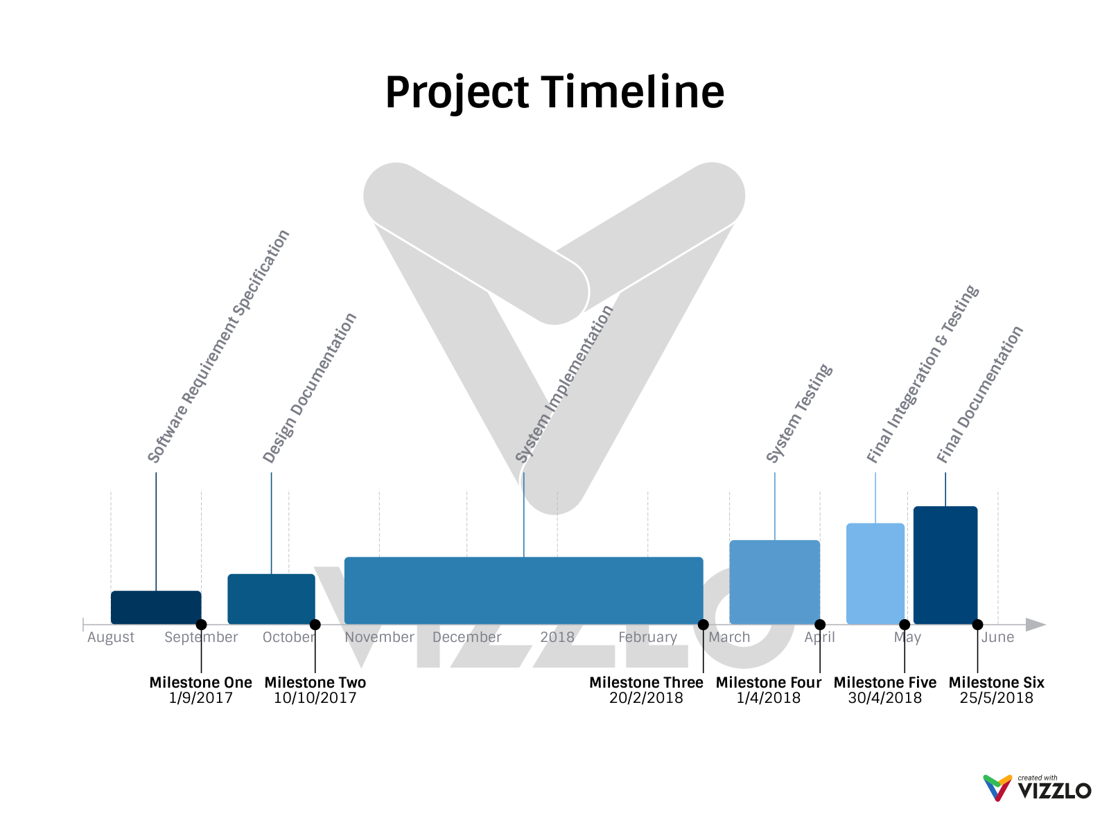
Timeline

Slide 16

Q/A Session
Any Queries?

Slide 17

Thank You!

